Slide 1
Career Readiness, CTE, 21st Century Skills, & the Common Core: A World of Opportunity for California Schools
Educating for Careers Pre-Conference
Sacramento, California
March 2, 2014
David Militzer Rebecca Dedmond, Ph.D.
Education Programs Consultant Director, Freshman Transition Initiative
California Department of Education George Washington University
Dan Blake Carolyn Zachry
Director, Innovation & Partnerships Administrator, College & Career Transition
Sonoma County Office of Education California Department of Education

Slide 2
New Policies, New Initiatives, New Resources
David Militzer
California Department of Education

Slide 3
A Changing Terrain: Main “Drivers” of the Current System
Standards Movement
Raising the Expectations Bar
College Readiness for All
School-Based Accountability- NCLB and High Stakes Testing
Address the “Achievement Gap”

Slide 4
A Changing Terrain: New “Drivers”
CCSS & 21st Century Skills
Broader Assessments
Funding Equity vs. Student Need
Funding Flexibility & Local Accountability
Address the “Opportunity Gap”

Slide 5
A Changing Terrain: New Policy Initiatives & Resources
Common Core Implementation
New Assessment Measures for API
Local Control Funding Formula (LCFF)
Local Control Accountability Plan (LCAP)
New Model CTE Standards (including Standards for Career Ready Practice)
Career Pathways Trust
Career and College Readiness

Slide 6
California Career Pathways Trust Grant
Grants shall be available for K-14 career pathways programs that address any or all of the following goals:
Fund specialists to establish or enhance locally defined career pathway programs connecting education and business
Establish regional collaboratives and partnerships with business entities, community organizations, and postsecondary education
Develop and integrate standards-based academics with career curriculum following industry-based pathways aligned with growing economic sectors
4. Provide articulated pathways to postsecondary education aligned with regional economies
Leverage or build on any of the following:
Perkins, CPAs, ROCPs, etc.
Matching resources
The California Community Colleges Economic and Workforce Development Program and its sector strategies and deputy sector navigators
Participation in the local California Community Colleges Skills Panel

Slide 7
California Career Pathways Trust Grant
Grants shall be available for K-14 career pathways programs that address any or all of the following goals:
Fund specialists to establish or enhance locally defined career pathway programs connecting education and business
Establish regional collaboratives and partnerships with business entities, community organizations, and postsecondary education
Develop and integrate standards-based academics with career curriculum following industry-based pathways aligned with growing economic sectors
4. Provide articulated pathways to postsecondary education aligned with regional economies
Leverage or build on any of the following:
Perkins, CPAs, ROCPs, etc.
Matching resources
The California Community Colleges Economic and Workforce Development Program and its sector strategies and deputy sector navigators
Participation in the local California Community Colleges Skills Panel

Slide 8
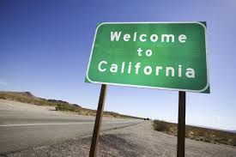
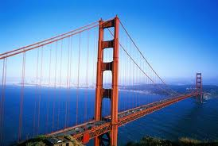
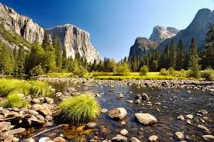
LCFF/LCAP: State Priorities
Conditions of Learning
Implementation of standards, course access, county coordination of expelled students, foster youth
B. Pupil Outcomes
Achievement: standardized tests, school API, pupils college and career ready, EL Learners who become proficient, EL reclassification rate, % who pass AP exams with 3 or higher, % deemed college ready by Early Assessment Program
Other pupil outcomes in subject areas
Engagement
Parent Involvement: in decision-making, promotion of Pupil Engagement, School Climate: suspension rate, expulsion rate, surveys of pupils, parents and teachers on sense of safety and school connectedness.
Pupil Engagement: School attendance rates, chronic absenteeism rates, middle school and high school dropout and graduation rates
and Optional Local Priorities

Slide 9
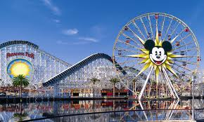
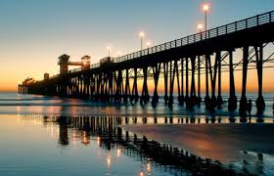
Local Examples: Orange County
Leadership of Orange County Office of Education
21st Century Learning Network
The Three Domains and the 5 C’s
Interpersonal ─ Communication, Collaboration Intrapersonal ─ Character
Cognitive ─ Critical thinking, Creativity
Extensive Professional Development and links to P21
Anaheim Union High School District’s 21st Century Skills Resolution, 2011
Savannah High School named “Partnership for 21st Century Skills Exemplar,” July 2013
Student Leadership Campaign for 21st Century Skills

Slide 10
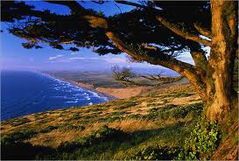
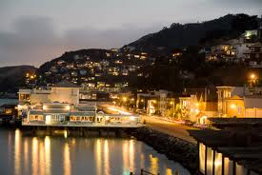
Local Examples: Marin County
New Playing Field ─ New Thinking
Develop Regional Plan with the essential components to meet requirements of LCFF
Applying CTE Standards and Expertise for Common Core Implementation
County-wide efforts to develop “Good Drivers”
Address challenges and opportunities associated with 21st century student outcomes, common core, and deeper learning with Personalized Learning Plans for all students
Use CTE Consortium to piece Regional Plan together with all stakeholders

Slide 11
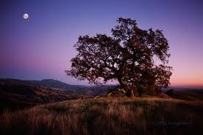
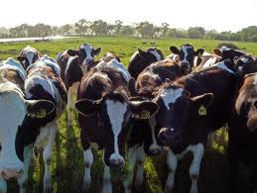
Local Examples: Sonoma County
Cradle to Career Sonoma Co. (Collective Impact)
Public/Private Partnerships
CTE Fund
North Bay Regional Collaborative
ieSonoma: innovate | educate
21st Century Teaching & Learning
Summer Institute
EdLeader 21
Project-Based Learning
21st Century Learning Environments
Technology Integration/Use of Social Media
Maker Movement
Design Thinking in Education
Integration of CTE & Core Academics
C3 / Math in CTE Project
Career & Education Planning for All Students (goal)
Middle School Career Exploration

